Slide 1
About Computer Architecture
What ?
Why?
Where ?

Slide 2
What?
Since 1946 all computers have had 5 components
Processor
Input
Control
Memory
Datapath
Output

Slide 3
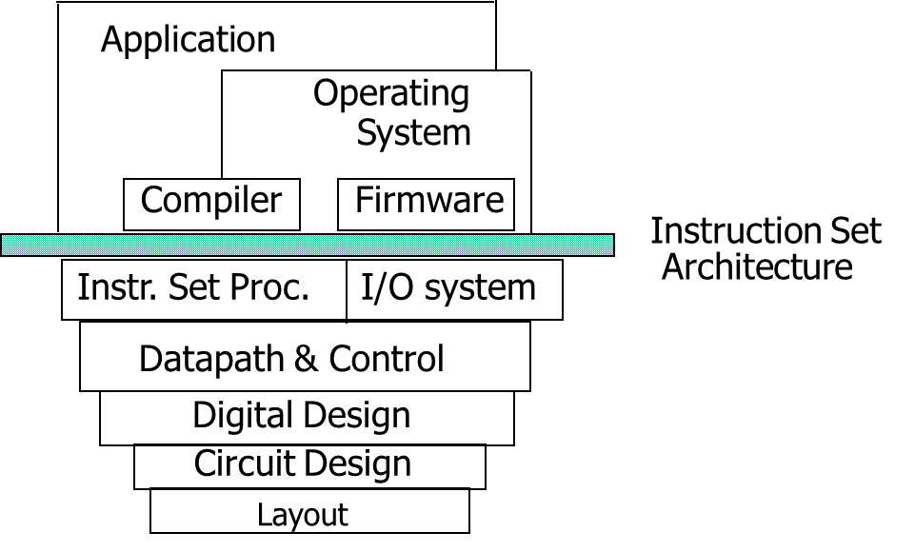
Computer Architecture
Coordination of many levels of abstraction
Under a rapidly changing set of forces
Design, Measurement, and Evaluation

Slide 4
Why?
Technology
Programming
Languages
Applications
Computer
Architecture
Cleverness
Operating
Systems
History

Slide 5
Why Computer Organization
Embarrassing if you are a BS in CS/CE and can’t
make sense of the following terms: DRAM, pipelining,
cache hierarchies, I/O, virtual memory, …
Embarrassing if you are a BS in CS/CE and can’t decide
which processor to buy: 3 GHz Xeon or 2.5 GHz Athlon
(helps us reason about performance/power), …
Obvious first step for chip designers, compiler/OS writers
Will knowledge of the hardware help you write better
and more secure programs?

Slide 6
Important Trends
Historical contributions to performance:
Better processes (faster devices) ~20%
Better circuits/pipelines ~15%
Better organization/architecture ~15%
In the future, bullet-2 will help little and bullet-1 will
eventually disappear!
Pentium P-Pro P-II P-III P-4 Itanium Montecito
Year 1993 95 97 99 2000 2002 2005
Transistors 3.1M 5.5M 7.5M 9.5M 42M 300M 1720M
Clock Speed 60M 200M 300M 500M 1500M 800M 1800M
Moore’s Law in action
At this point, adding transistors
to a core yields little benefit

Slide 7
What Does This Mean to a Programmer?
Today, one can expect only a 20% annual improvement;
the improvement is even lower if the program is not
multi-threaded
A program needs many threads
The threads need efficient synchronization and
communication
Data placement in the memory hierarchy is important
Accelerators should be used when possible

Slide 8
Challenges for Hardware Designers
Find efficient ways to
improve single-thread performance and energy
improve data sharing
boost programmer productivity
manage the memory system
build accelerators for important kernels
provide security

Slide 9
The HW/SW Interface
Application software
a[i] = b[i] + c;
Compiler
lw $15, 0($2)
add $16, $15, $14
add $17, $15, $13
lw $18, 0($12)
lw $19, 0($17)
add $20, $18, $19
sw $20, 0($16)
Systems software
(OS, compiler)
Assembler
Hardware
000000101100000
110100000100010
…

Slide 10
Computer Components
Input/output devices
Secondary storage: non-volatile, slower, cheaper
Primary storage: volatile, faster, costlier
CPU/processor (datapath and control)

Slide 11
Performance
Purchasing perspective
Given a collection of machines, which has the
Best performance ?
Least cost ?
Best performance / cost ?
Design perspective
Faced with design options, which has the
Best performance improvement ?
Least cost ?
Best performance / cost ?
Both require
basis for comparison
metric for evaluation
Our goal: understand cost & performance implications of architectural
choices

